Slide 1
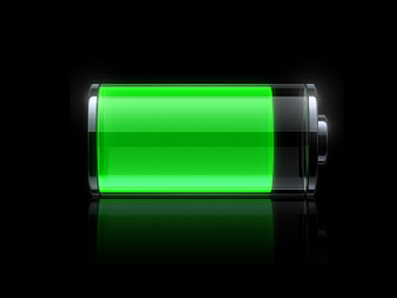

Electrical Power Subsystem

Slide 2
Electricity
Learn additional info
More accuracy/less approximations
Gain an idea of what these systems look like

Slide 3
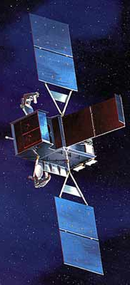
AOCS 150 W
propulsion 100 W
Payload 200 W
CDHS 100 W
TOTAL 550 W

Slide 4
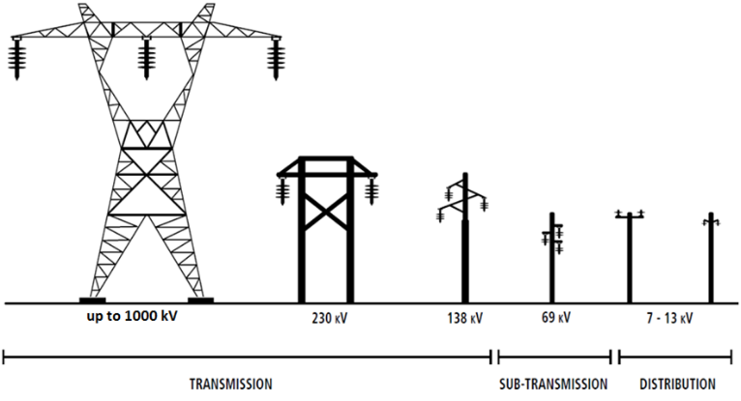
Electricity
Functions of EPS
Energy Generation
Energy Storage
Energy distribution
Energy regulation
Notes:
Low voltage – 1000 V
Medium – up to 69 kV
High – less than 100kV
Extra high – up to 800kV
Ultra high – more than 800kV

Slide 5
Where do we start?
Requirements!
Spacecraft power
Peak power
Avg power
Voltage
Current

Slide 6
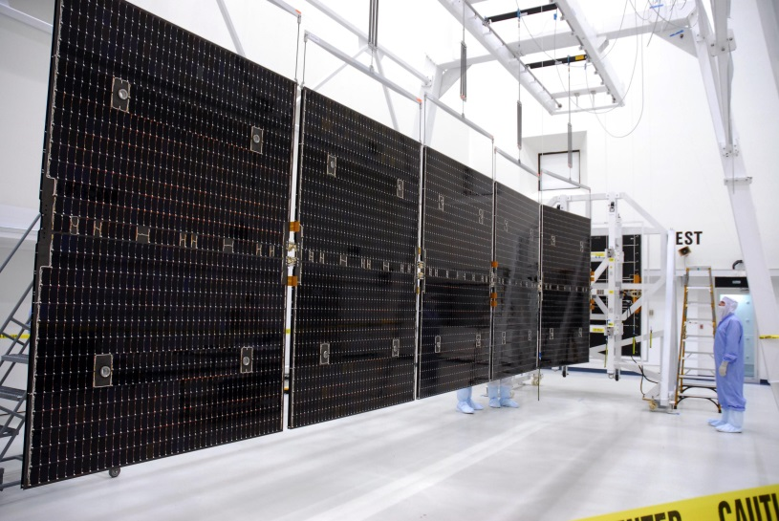
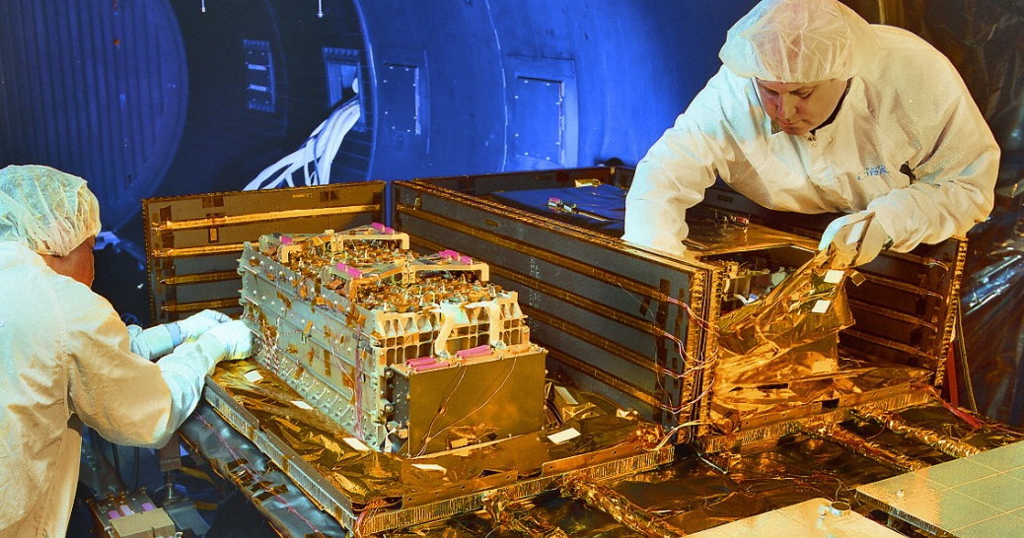
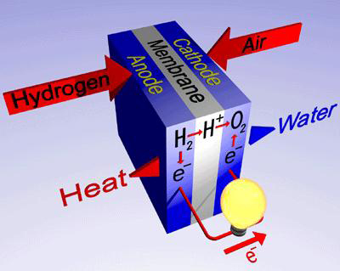
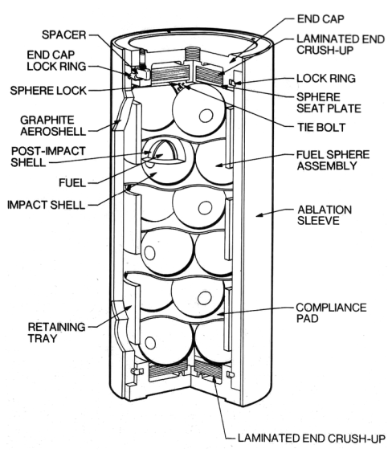

Slide 7
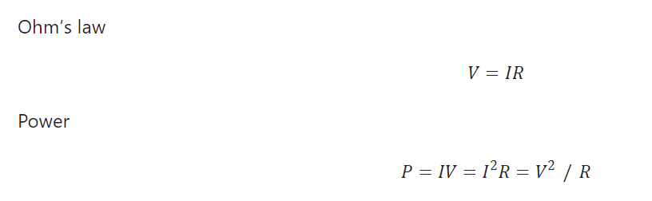
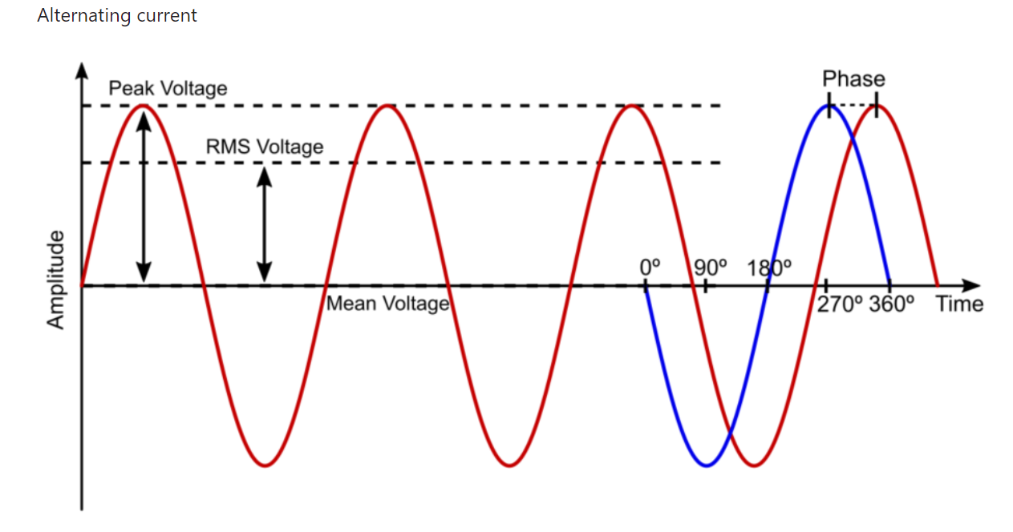
Electrical Fundamentals
Notes:
US standard for house:
120 V
15 – 20 Amp
Single Phase or for 240 V 180 phase

Slide 8
Energy Generation
1888 – Russian physicist Aleksandr Stoletov built the first cell based on the outer photoelectric effect discovered by Heinrich Hertz in 1887.[11]
1904 – Julius Elster, together with Hans Friedrich Geitel, devised the first practical photoelectric cell.[12]
1905 – Albert Einstein proposed a new quantum theory of light and explained the photoelectric effect in a landmark paper, for which he received the Nobel Prize in Physics in 1921.[13]
1954 – The first practical photovoltaic cell was publicly demonstrated at Bell Laboratories.[18] The inventors were Calvin Souther Fuller, Daryl Chapin and Gerald Pearson.[19]
1958 – Solar cells gained prominence with their incorporation onto the Vanguard I satellite.

Slide 9
Solar Cell
Directly convert light energy into electrical energy.
How big do they need to be? How much energy do they need to provide?

Slide 10
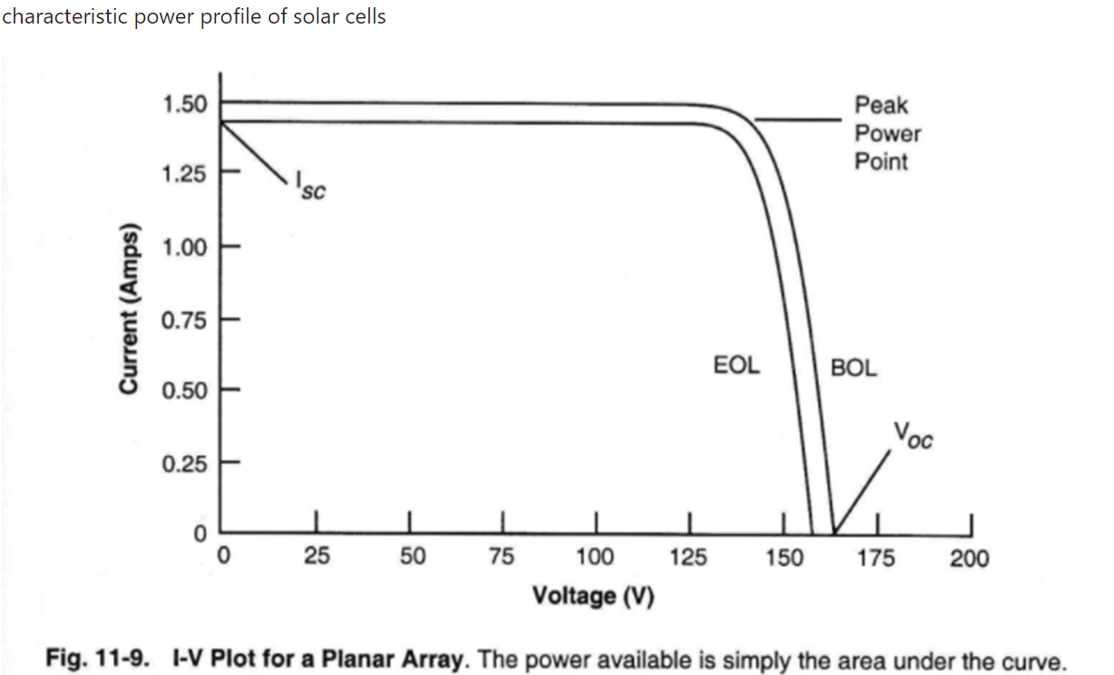
Efficiency Calculation: Helps in determining the efficiency of the solar cell by identifying the Maximum Power Point.
Performance Evaluation: Assesses how well the solar cell performs under different lighting conditions.
Quality Control: Ensures that the solar cells meet the required specifications and standards.
I-V Plot
Efficiency Calculation: Helps in determining the efficiency of the solar cell by identifying the Maximum Power Point.
Performance Evaluation: Assesses how well the solar cell performs under different lighting conditions.
Quality Control: Ensures that the solar cells meet the required specifications and standards.
Notes:
Isc = short circuit current V=0
Voc = voltage open current I=0 – max voltage cell can produce

Slide 11
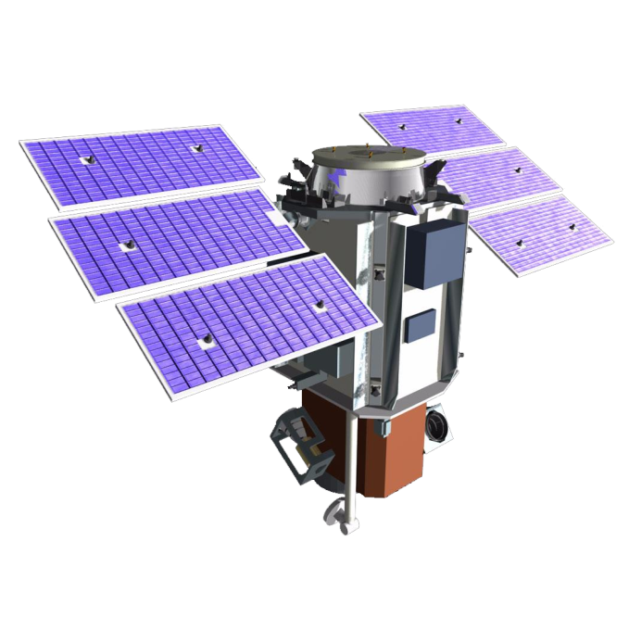

Slide 12

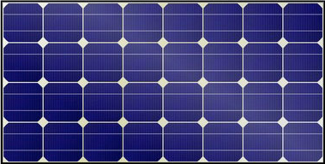
subsystems + payload
battery

Slide 13


Time of Eclipse (TE)
LEO
MEO

Slide 14
Energy in the Sun vs. Eclipse
What is Esun/ecl? Equation? Why different for sun/eclipse?
What is η? Why different for sun/eclipse? Which is higher?
What is the consequence of η?
Notes:
Home Solar Panels 15-18%
High efficiency 20-22%
S/C 25-35%
Higher efficiency directly from array’s, extra path to batteries

Slide 15
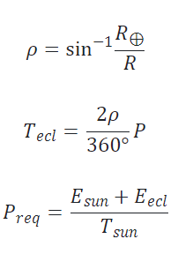
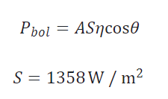

Energy in the Sun vs. Eclipse

Slide 16
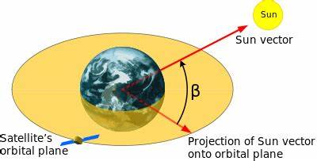
Time in Eclipse
Max: when orbital plane aligns with…
ecliptic plane.
Shorter: all other times
Shortest: no eclipse
some (many) sun-synchronous orbits
GEO for most of the year—why?
beta angle: angle between orbital plane and sun vector
formally: angle between solar vector and its projection onto the orbit plane
Real cells
Rocketlab IMM: η = 33%

Slide 17
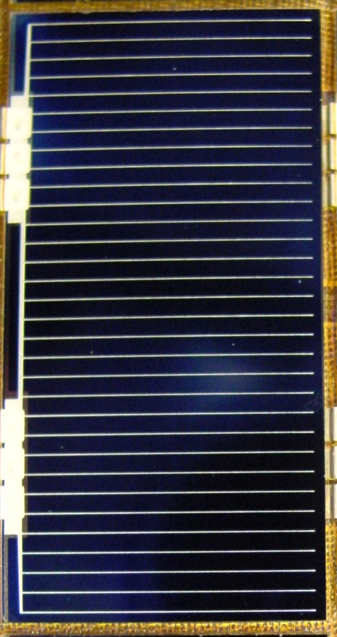
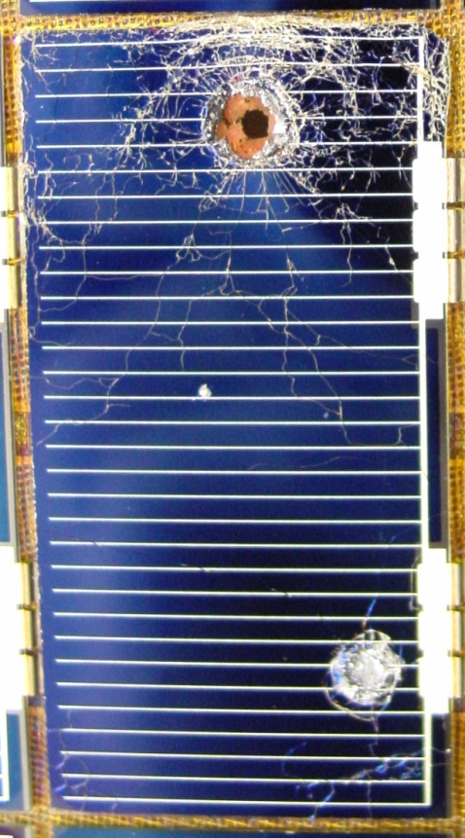


$$P_{BOL}$$
$$P_{EOL}$$
Mission Life

Slide 18

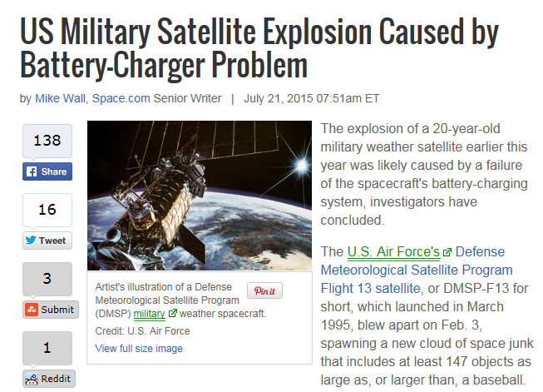
Battery Capacity
DOD

Slide 19
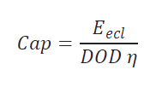
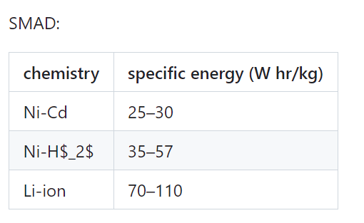
Battery Capacity

Slide 20
